Slide 1
Group 3, Final Presentation
Madalyn Alm, Kathryn Atherton, Barbara McAnulty, Sarah McGinness

Slide 2
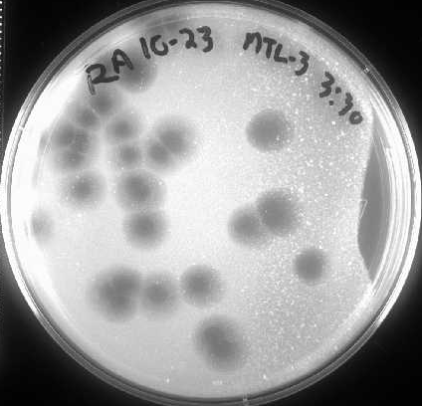
Introduction
This research aims to produce an annotated genome of JewelBug, a newly discovered species of mycobacteriophage, for the SEA-PHAGES project.
Mycobacteriophage are virions that infect mycobacteria in order to replicate.
The SEA-PHAGES project is an international effort of students characterizing mycobacteriophage found in the environment to discover new genes and their functions.
JewelBug’s plaques after infecting mycobacterium smegmatis

Slide 3
Why this annotation is important
Viruses are the most genetically diverse group of biological material as well as the least studied. Therefore, they contain the largest number of novel genes.
Expanding the databases of viral genomes allows for more efficient and higher-quality future annotations.
The databases provide the groundwork for research into the evolution and adaptation of viruses which also provides information about evolution, adaptation, and susceptibility of bacteria. Two paramount concerns for human medicine.
Mycobacteriophages have specific applications in human medicine since their hosts include M. tuberculosis.

Slide 4
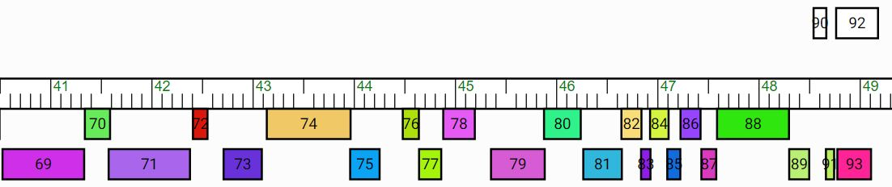

Genes 67-90: 40900-50341bp
Gene Inserted
Gene Extended Significantly
Two Genes Deleted
78
24 genes originally called 23 genes in final annotation
(two deletions and one addition)
In the manually validated draft these two forward- reading genes are eliminated.

Slide 5
General Characteristics
All features were read in the backward direction in the complementary strand
61.6% GC
Start codon frequency: 8.7% TTG, 37.1% ATG, 52.2% GTG
According to the Annotation Guide, TTG should be around 7% and GTG and ATG should be about 46.5% each
Most BLAST results were hypothetical proteins

Slide 6
General Characteristics
A6 phages most closely related to JewelBug based on BLAST and Phamerator:
VOHMINGHAZI
ISIPHIWO
MCFLY
KAZAN
CLOUDWANG9
ARTEMIS2UCLA

Slide 7
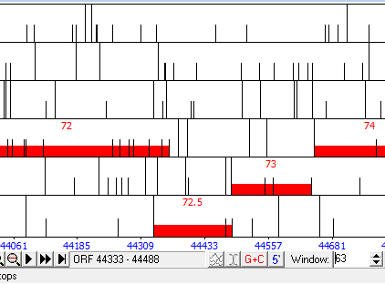
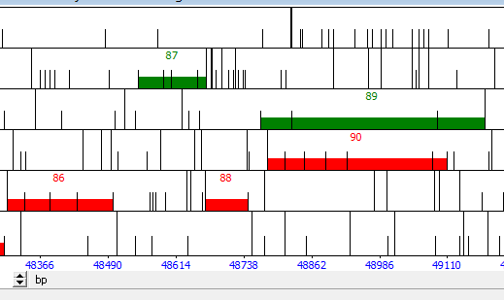
Major Changes in the Genome
Adding a gene between features 72 and 73
There was a large 119 bp gap, GeneMark coding potential, and significant blast results once this feature was added
Deleting features 87 and 89
Both features 87 and 89 were in the forward direction, even though all of the other features in this part of the genome were in the reverse direction
The features did not have strong BLAST results, if any, and there is not enough space between the surrounding genes to suggest a reversal of direction. Features 86, 88, and 90, on the other hand, have stronger evidence supporting their existence

Slide 8
Noteable Functions
A significant proportion of our features had no known function after thorough analysis of the available evidence.
The genes in our sections that did have supported putative functions were regulatory proteins (promoters and anti-repressors) or associated with DNA (DNA methylase and a helix-turn-helix domain).
The majority of our features were similar with to features of other phages found within the A6 cluster with a few exceptions.

Slide 9
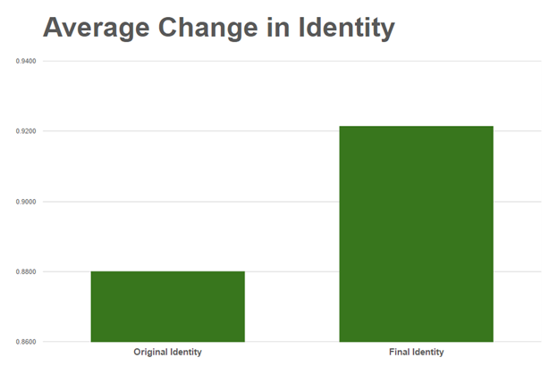
Improvements from auto-annotation
By moving a few start sites, the team was able to improve identity of JewelBug’s proteins with proteins in the BLAST database by 4.7%.

Slide 10
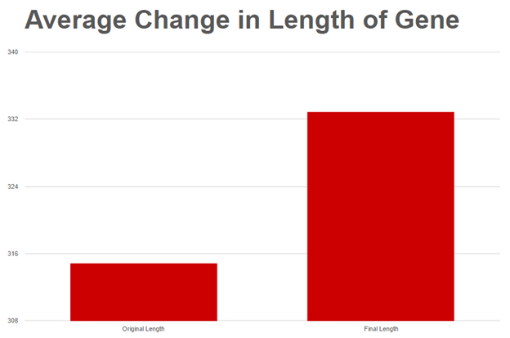
Improvements from auto-annotation
By moving a few start sites, the team was able to improve the length of genes by 5.7%, which reduces the gap between genes.

Slide 11
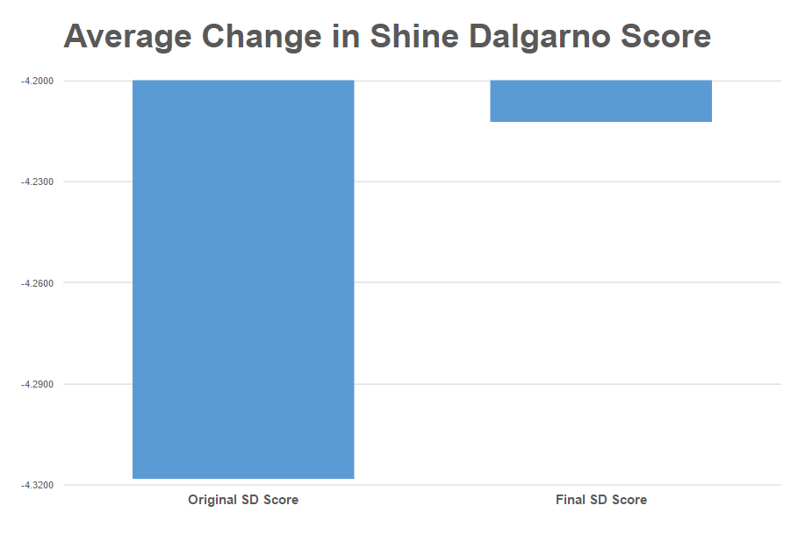
Improvements from auto-annotation
By moving a few start sites, the team was able to improve Shine Dalgarno scores, a measure of the ability of ribosomes to initiate protein synthesis. The SD scores became 2.5% less negative. Although SD scores are not the most important measure, the guiding principles do call for a score closer to zero.

Slide 12
Conclusions
The auto-annotation by DNAMaster utilizing GeneMark and Glimmer gene call algorithms required several revisions including two gene deletions, one gene addition, and many start adjustments on its 40900 - 50341 base pair section.
Wet lab evidence suggests that the JewelBug is a temperate phage. If this is the case, the genes found in this section of the genome are likely instrumental in the regulation of the JewelBug’s life cycle as well as determining its host range.

Slide 13
Future Work
Send the completed annotation to University of Pittsburgh Howard Hughes Medical Institute quality control for wet lab verification of the gene calls
Determine the function of the proteins that currently do not have a known function
Determine the host range of JewelBug
Compare to the rest of the A6 cluster to determine possible evolutionary path

Slide 14
Thanks for a Great Semester!
Special Thanks to Dr. Clase and Yi!!!

